Slide 1
Arrays in Java Lecture - 9
Prepared By - Rupali Patil

Slide 2
Contents
Arrays in Java
Array initialization
Default Array values
Multi dimensional array

Slide 3
Arrays in Java
An array is a collection of homogeneous elements that are referred to by a common name.
In Java all arrays are dynamically allocated.
Since arrays are objects in Java, we can find their length using the object property length.
The direct superclass of an array type is object.
Arrays can be created for primitive as well as non primitive data types.

Slide 4
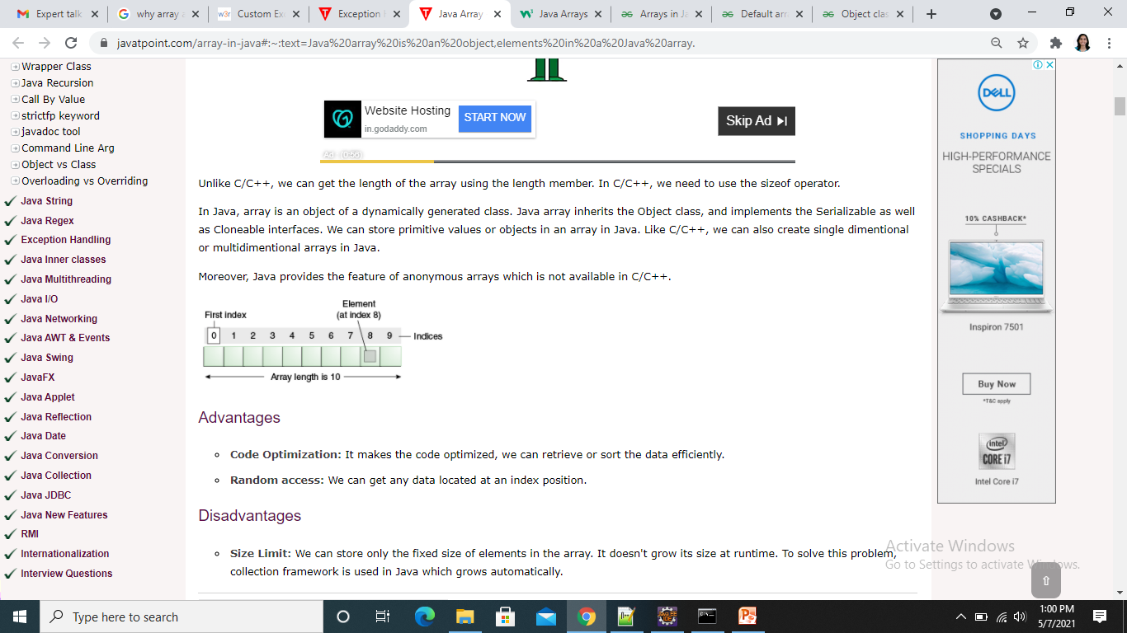
Array Declaration and Initialization
Using literals
e. g. int [] x = {1,2,3,4,5,6,7,8,9,10};
Using new keyword
e.g int [] x = new int[10];

Slide 5
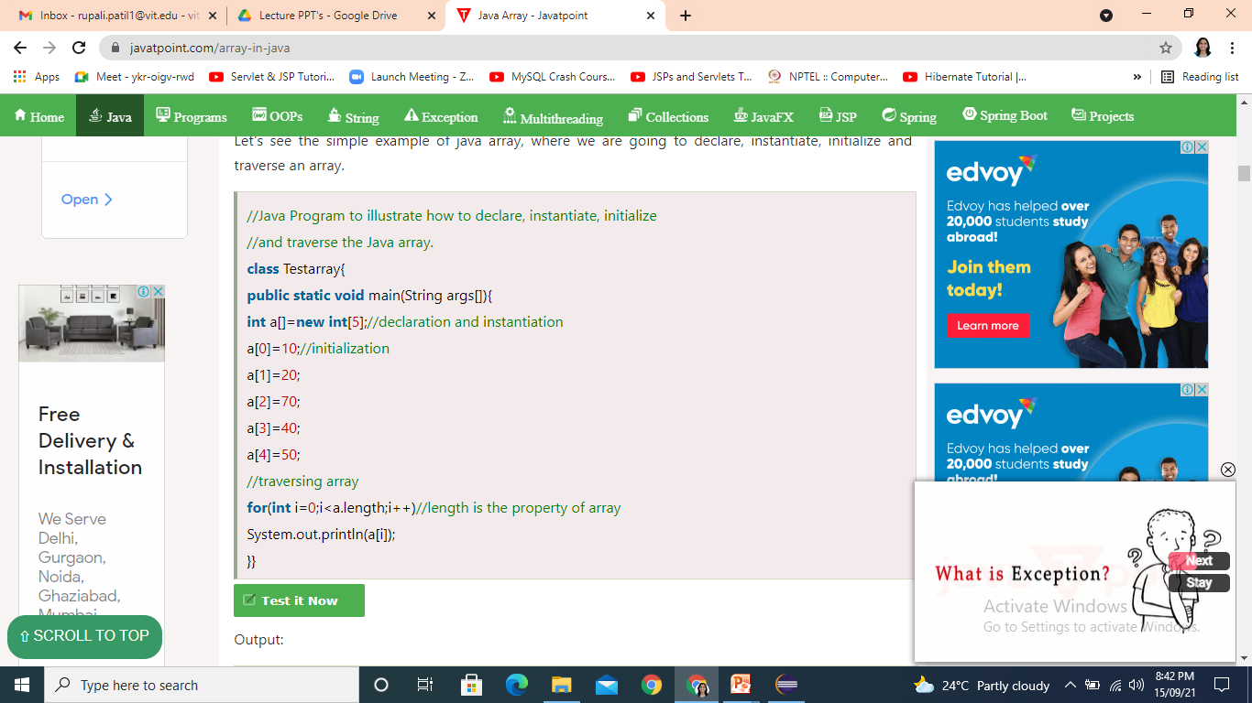
Array Declaration and Initialization contd..
Example of array declaration, initialization

Slide 6
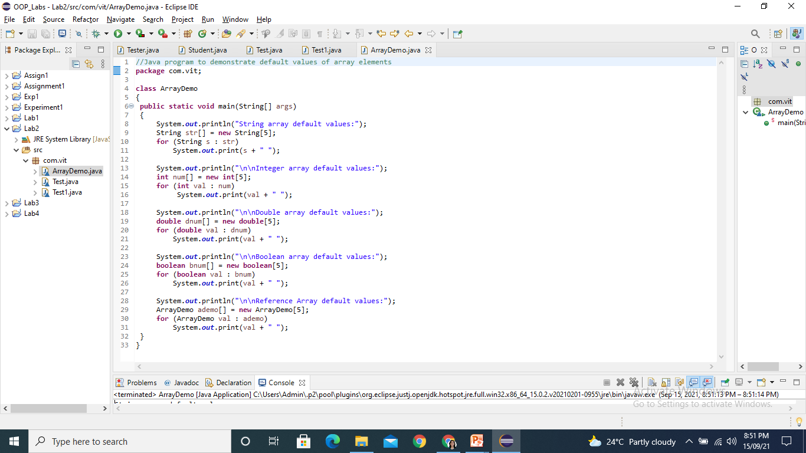
Default Array values

Slide 7
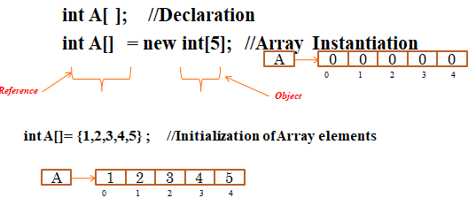
Types of Arrays
Single Dimensional Array(1D)
Multi Dimensional Array

Slide 8
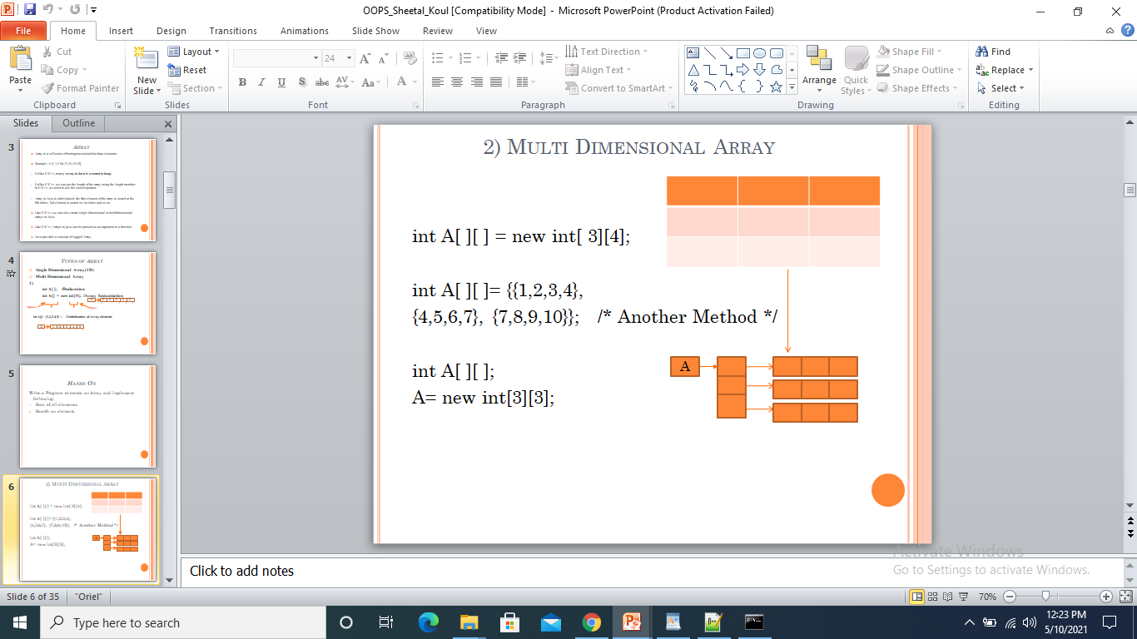
Two Dimensional Array

Slide 9
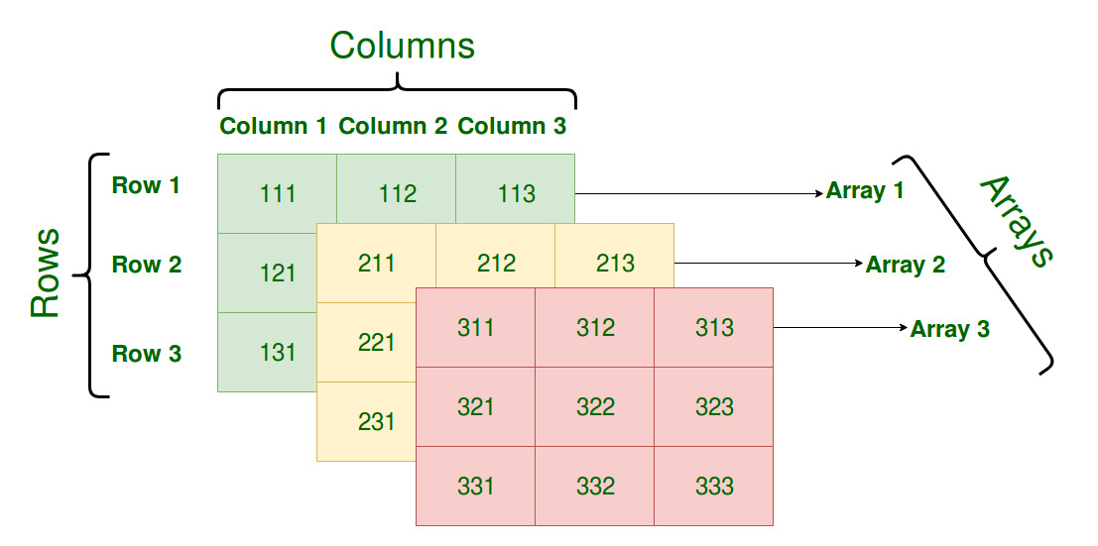
Three Dimensional Array

Slide 10
Thank You

